Slide 1
Genetic algorithm
Mohammad gh

Slide 2
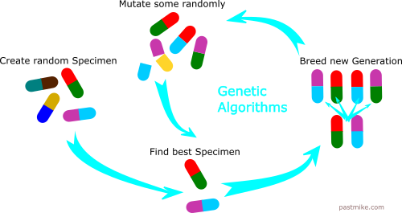
What is genetic algorithm

Slide 3
Main idea
Selection force
Resource
Keep population small
Reproduction force
Makes new individuals

Slide 4
Genetic algorithm in nature
DNA
Chromosome
Natural selection
Reproduction
Evolution

Slide 5
Genetic algorithm in machine learning
We have a set of weights
Like DNA and chromosomes
We want to minimize cost function
Fittest individual is the one with lowest cost

Slide 6
Genetic algorithm
End
No
Yes
Initialize population
Fitness calculation
Result
Parent selection
crossover
Mutation
Survival selection

Slide 7
example
We want to find best weights for a neural network:
10 input neurons – 20 hidden neurons – 3 output neurons
(10 + 1) * 20 + (20 + 1) * 3 weights = 283 weights
We have a chromosome with 283 real numbers
Make 100 random NNs, each with 283 random weights
Compute Cost
Select parents
…

Slide 8
fitness
Fitness is equal to cost function
MSE
Cross Entropy
regularization
...

Slide 9

Parent selectin
Uniform random
Fitness proportional
$P\left(individual t be parent\right)=\frac{fitness_{t}}{\sum{fitness_{i}}}$

Slide 10
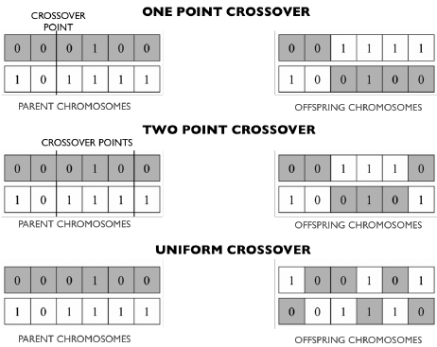
Crossover

Slide 11
mutation
We have a small mutation chance
Just reset the weight to a new random number
Or add a small random number to weight
Guarantees finding the best solution

Slide 12
Survival selection
(μ + λ) Selection
Select from parents and offspring
(μ, λ) Selection
Just select from offspring

